Slide 1
GAN

Slide 2
Generative Adversarial Networks (GANs)
Generative Adversarial Networks (GANs) are a type of deep learning model composed of two neural networks: a generator and a discriminator.
GANs are designed for generating data that closely resembles the one in the training set.
gen
data
Generator
gen
Discriminator
z
fake
real

Slide 3
GANs: Discriminator
The discriminator is a binary classifier with one output.
The discriminator is trained to distinguish between real images (output 1) and generated images (output 0)
Discriminator
generated
0
Discriminator
real
1

Slide 4
GANs: Generator
The generator is trained to produce images that can deceive the discriminator.
It takes random noise as input and aims to generate an output that, when presented to the discriminator, is classified as 'real'.
Generator
Discriminator
z
“real”

Slide 5
GANs: Discriminator Training
real image
real image
Discriminator
real
real image
fake
The discriminator takes one image as input (a batch) and output one label (a batch).
NOT pairs
z₀
Generator
z₁
z₂
We do NOT train the generator.
Compute gradients only for the discrminator

Slide 6
GANs: Generator Training
Discriminator
real
z₀
Generator
z₁
z₂
We do NOT train the discriminator.
Compute gradients only for the generator

Slide 7
GAN Training: Discriminator CG
image₀
Discriminator
P(real | i₀)
Logistic
Regression
image₁
P(real | i₁)
real_loss
image₂
P(real | i₂)
Discriminator Optimizer
+
loss
z₀
Generator
Discriminator
P(fake | g₀)
Logistic
Regression
z₁
P(fake | g₁)
fake_loss
z₂
P(fake | g₂)

Slide 8
GAN Training: Generator CG
the discriminator should classify the generated image as REAL
z₀
Generator
Discriminator
P(real | g₀)
Logistic
Regression
z₁
P(real | g₁)
loss
z₂
P(real | g₂)
Generator
Optimizer

Slide 9
GANs: Discriminator training in practice
To train a GAN network we use two optimizer: one for each network.
To train the discriminator:
randomly sample some real data from the dataset
generate some fake data using the generator
feed the discriminator with the real data and compute the error of the predicted label w.r.t. 1 (1 is the real label)
feed the discriminator with the fake data and compute the error of the predicted labels w.r.t. 0 (0 is the fake label)
compute the total error as the mean of the two errors
compute the gradients of the error w.r.t. the discriminator weights
update the discriminator weights

Slide 10
GANs: Generator training in practice
To train the generator:
generate some fake data using the generator
feed the discriminator with the fake data and compute the error of the predicted labels w.r.t. 1 (1 is the real label)
compute the gradients of the error w.r.t. the generator weights
update the generator weights

Slide 11

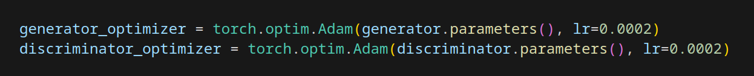
GANs: PyTorch (initialization)

Slide 12
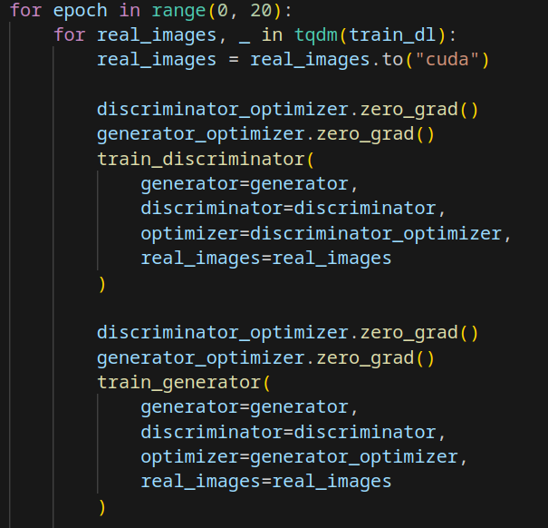
GANs: PyTorch (training loop)

Slide 13
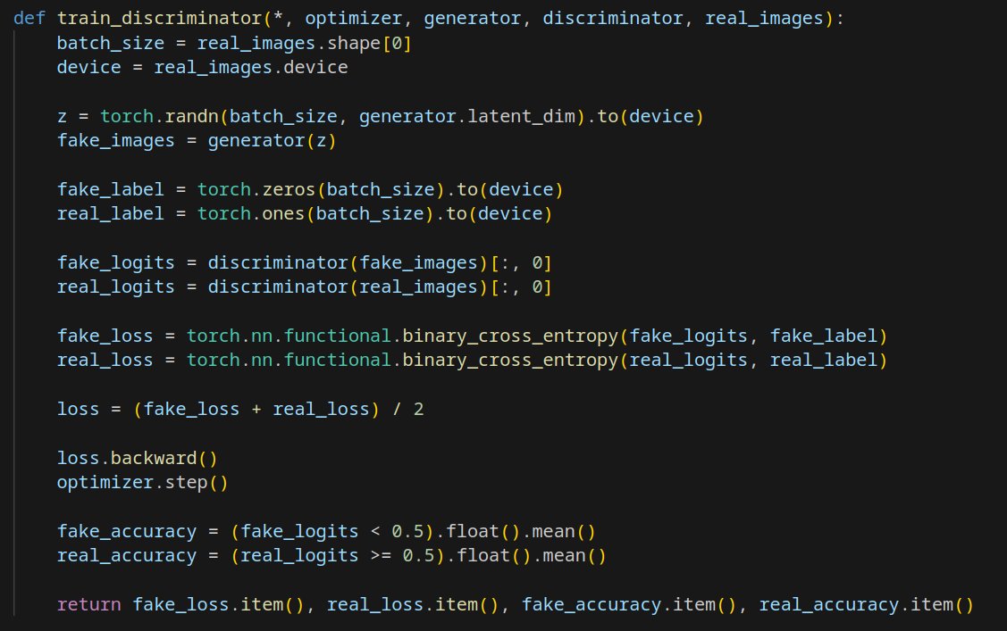
GANs: PyTorch (discriminator training)

Slide 14
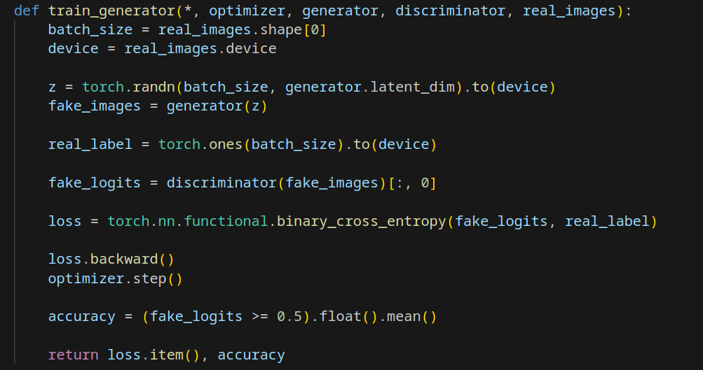
GANs: PyTorch (generator training)

Slide 15
Auxiliary Classifier GAN
Auxiliary Classifier GAN (ACGAN) is a variant of the standard GAN architecture that enhances generative capabilities by integrating an auxiliary classifier into the discriminator.
It is ideal for conditional image generation and other tasks requiring class-specific data synthesis.

Slide 16
ACGANs: Generator Training
random classes
c₀
Classification
Head
random
classes
c₁
c₂
Generator
Discriminator
Backbone
z₀
Validity
Head
real
z₁
z₂
random noise

Slide 17
ACGANs: Discriminator Training (generated images)
random classes
c₀
Classification
Head
random
classes
c₁
c₂
Generator
Discriminator
Backbone
z₀
Validity
Head
fake
z₁
z₂
random noise

Slide 18
ACGANs: Discriminator Training (real images)
real classes
Classification
Head
c₀
output
classes
c₁
c₂
Discriminator
Backbone
image₀
Validity
Head
real
image₁
image₂
real images

Slide 19
GAN training ticks
Training a GAN is a very unstable process, and finding the right balance between the generator and discriminator can be quite tricky.
There are some known tricks to help speed up and stabilize the training process:
Normalize images between -1 and 1
Use torchvision.transforms.Normalize((0.5,), (0.5,)) for MNIST
Avoid MLP, use CNN (called DCGAN Deep Convolutional GAN)
Use torch.nn.BatchNorm2d every layer
Avoid MaxPool2d, use strided convolutions
Initialize convolution weights to almost 0 (normal mean 0 and std 0.02)
Initialize batchnorm weights to almost 1 (normal mean 1 and std 0.02)

Slide 20
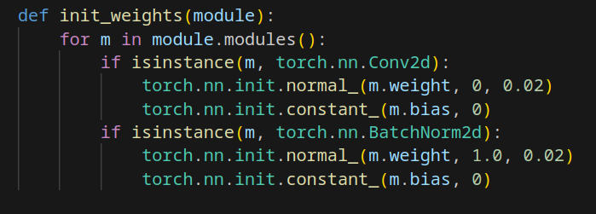
GAN training ticks: in PyTorch (Initialization)

Slide 21
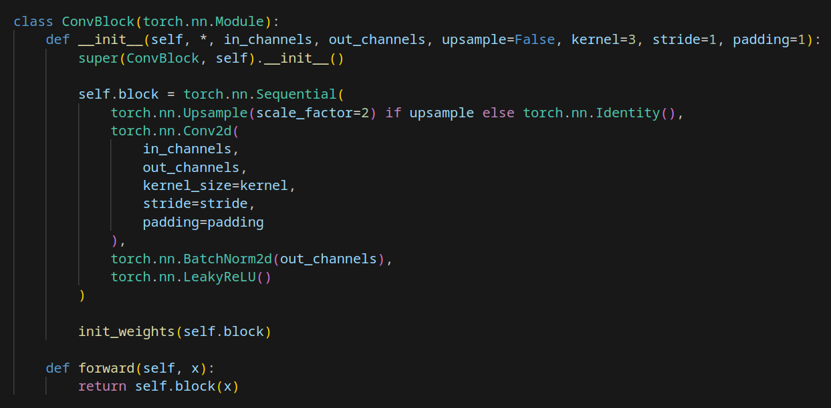
GAN training ticks: in PyTorch (Conv block)

Slide 22
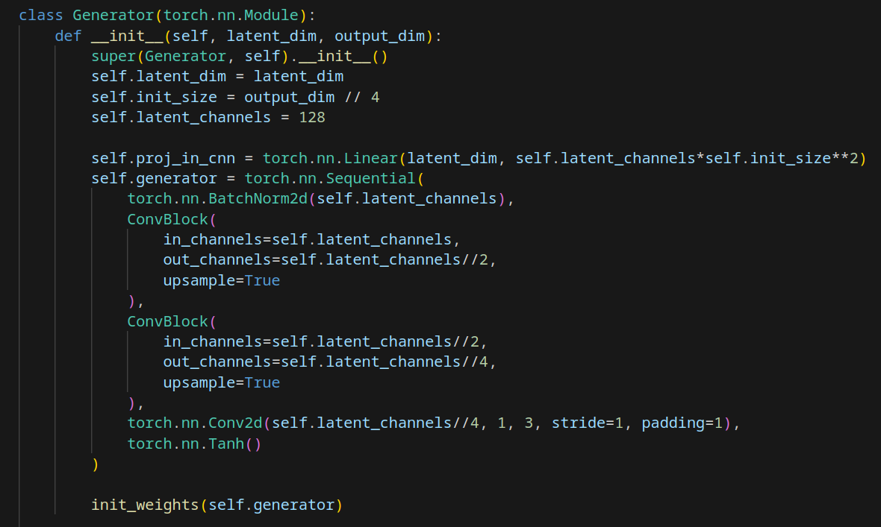
GAN training ticks: in PyTorch (Generator example)

Slide 23
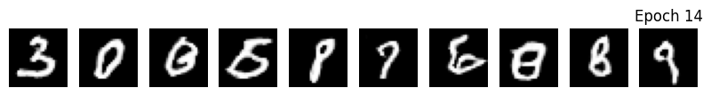
Exercise 1 (doable)
Train a DCGAN on the MNIST dataset
Train the DCGAN for 20 epochs
After each epoch plot 10 random images generated by the generator
Tip: be gentle, use a small learning rate (like 0.0002)

Slide 24
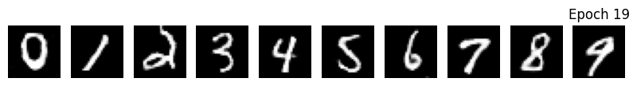
Exercise 2 (very hard)
Train a ACGAN on the MNIST dataset
Train the ACGAN for 20 epochs
After each epoch plot one random image for each class generated by the generator
Be creative, come up with a teqnique to mix the class and noise in a way that preserve both randomness and class information
Tip: If your ACGAN does not generate conditional images (ignore the class information) you can weight the validity and classification losses (0.01 for the validity loss is a good number)
Tip: You can use the torch.nn.Embedding to project integers into vectors (like the VQ-VAE codebook)

